Slide 1
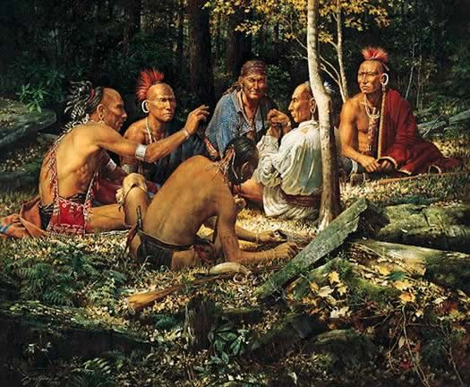
Native Americans
In Pennsylvania
Chapter 3, Lesson 2- Part 1
Pgs. 86-91

Slide 2
Watch the video Native Peoples of the Regions
Write why you think there are so many Native American tribes.
Share with a partner.

Slide 3
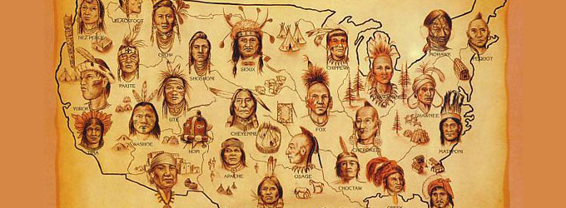
Native Americans, also known as American Indians, lived in North America for many years before people from Europe knew they lived there.

Slide 4
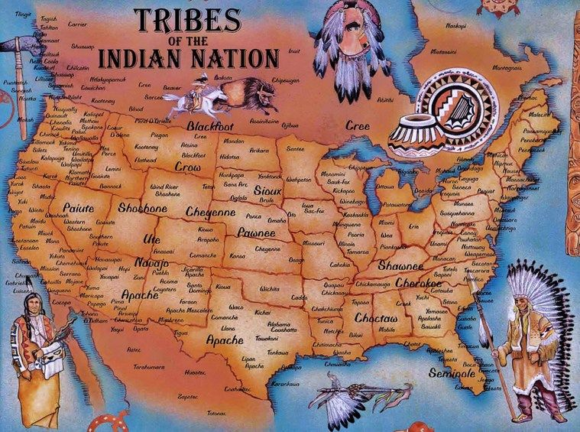
These Native Americans lived in groups called tribes. There were many tribes in North America.

Slide 5
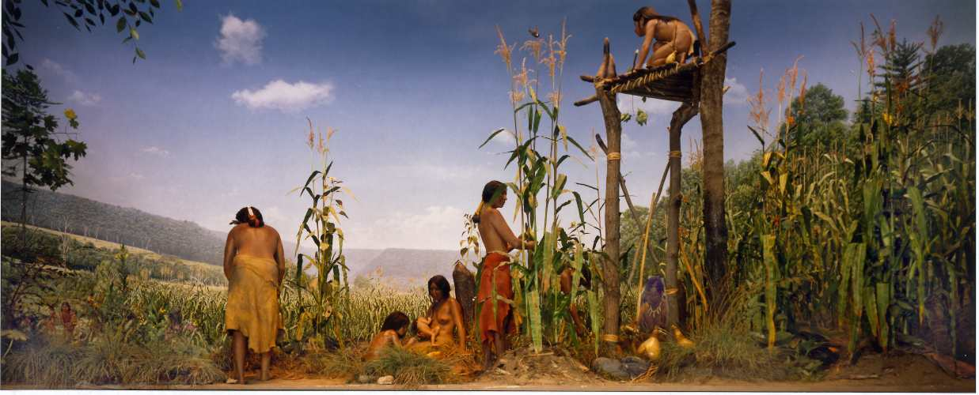
These Native Americans were able to live in an area longer than their nomadic ancestors because they started growing their own crops for food.

Slide 6
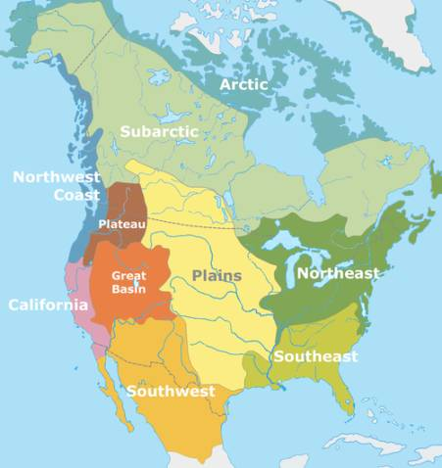
Tribes living in the same type of environment had many similarities.

Slide 7
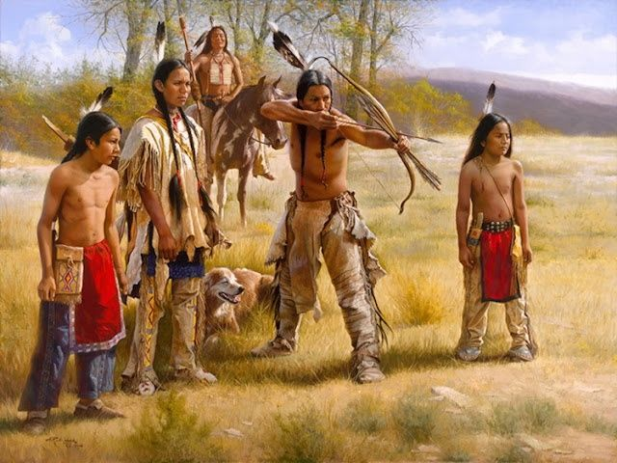
Some of these similarities included the food they ate, what their homes were made out of, and the types of clothing they wore.

Slide 8
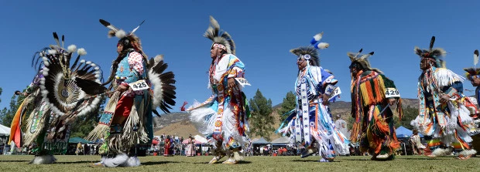
These tribes may also had some differences like the languages they spoke, their religion and customs, and how their tribes were organized.

Slide 9
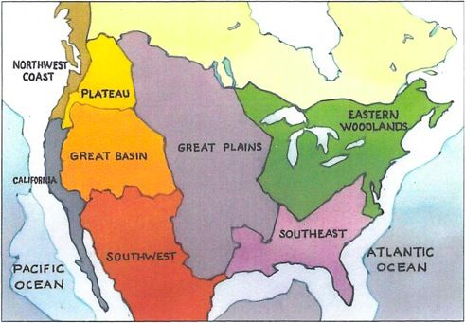
The tribes that live in what is now Pennsylvania were a part of a group called the Eastern Woodland Indians, sometimes called Native Americans of the Northeast.

Slide 10
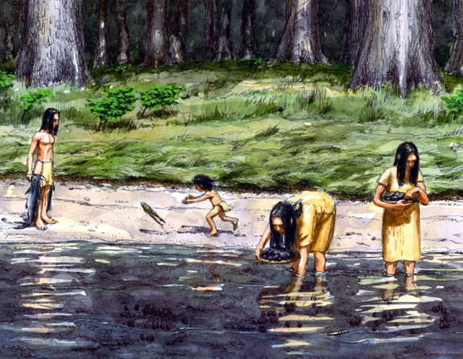
These Native Americans got everything they needed to survive from nature.

Slide 11
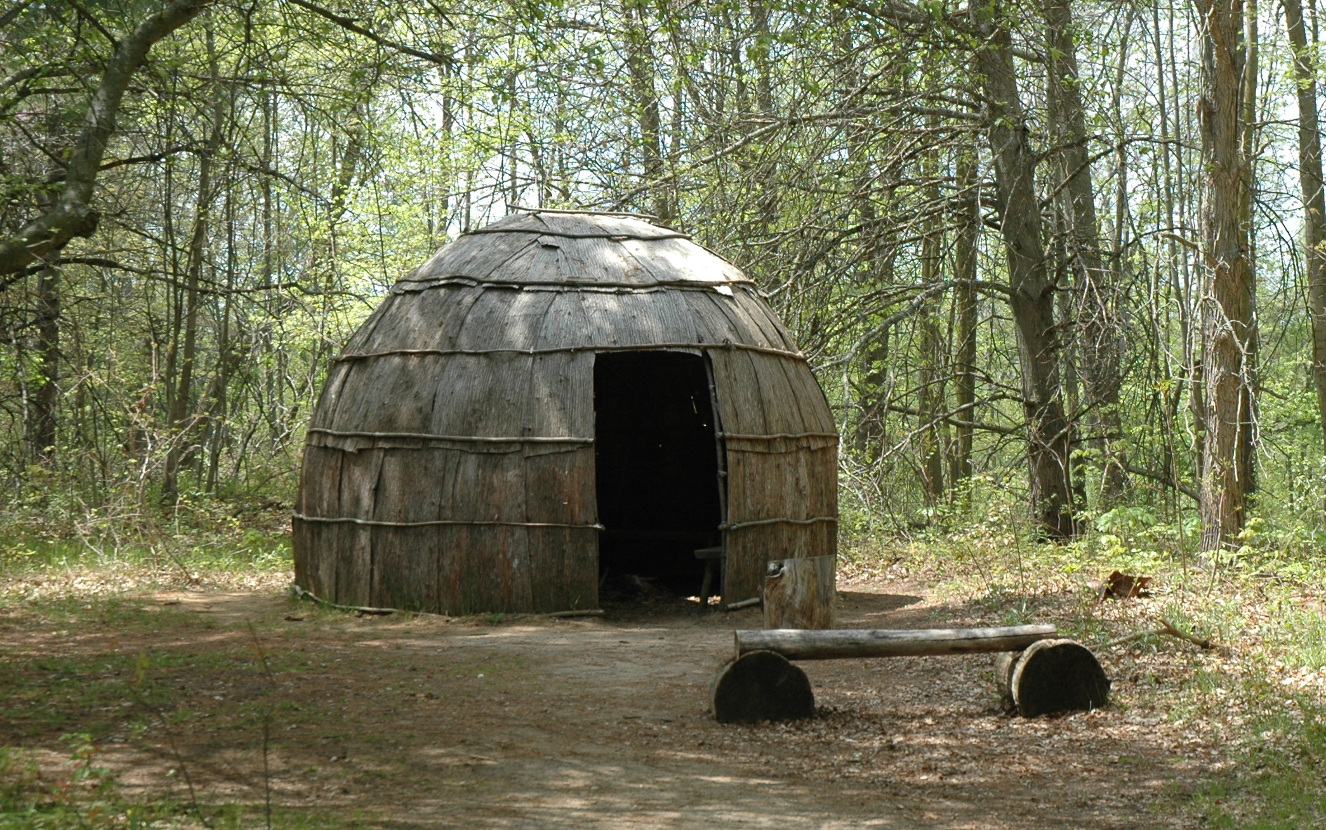
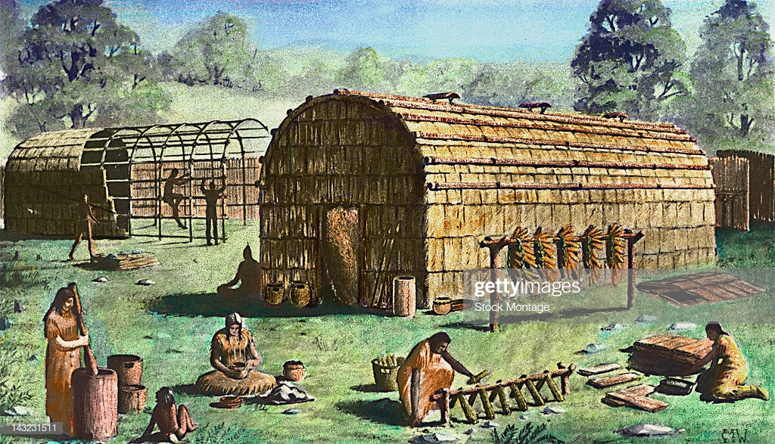
The Eastern Woodland Indians of Pennsylvania lived in homes made out of small trees covered with bark.
These homes were called wigwams and longhouses.

Slide 12
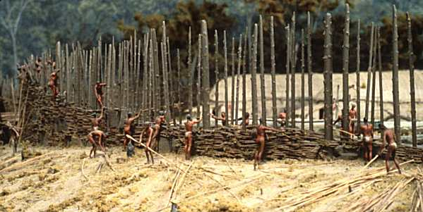
Some Native American tribes build log walls, called palisades, around their villages for protection.

Slide 13
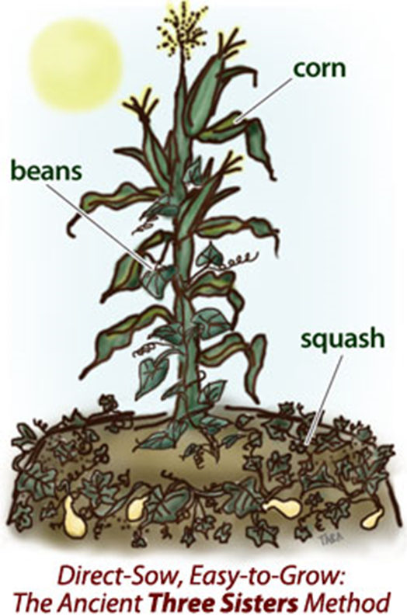
Native Americans of the Eastern Woodland tribes grew their own food like corn, beans, and squash. They also gathered nuts, berries, and fruit.
“The Three Sisters”

Slide 14
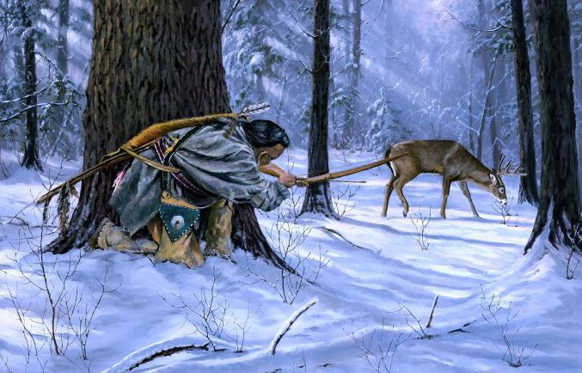
These Eastern Woodland Indians also hunted and fished for food.

Slide 15
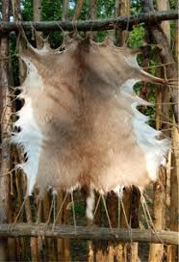
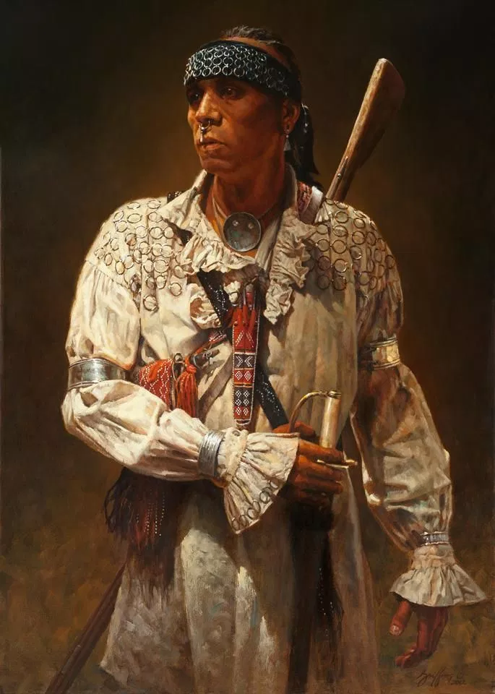
The clothing they wore came from the skins of the animals they hunted.

Slide 16
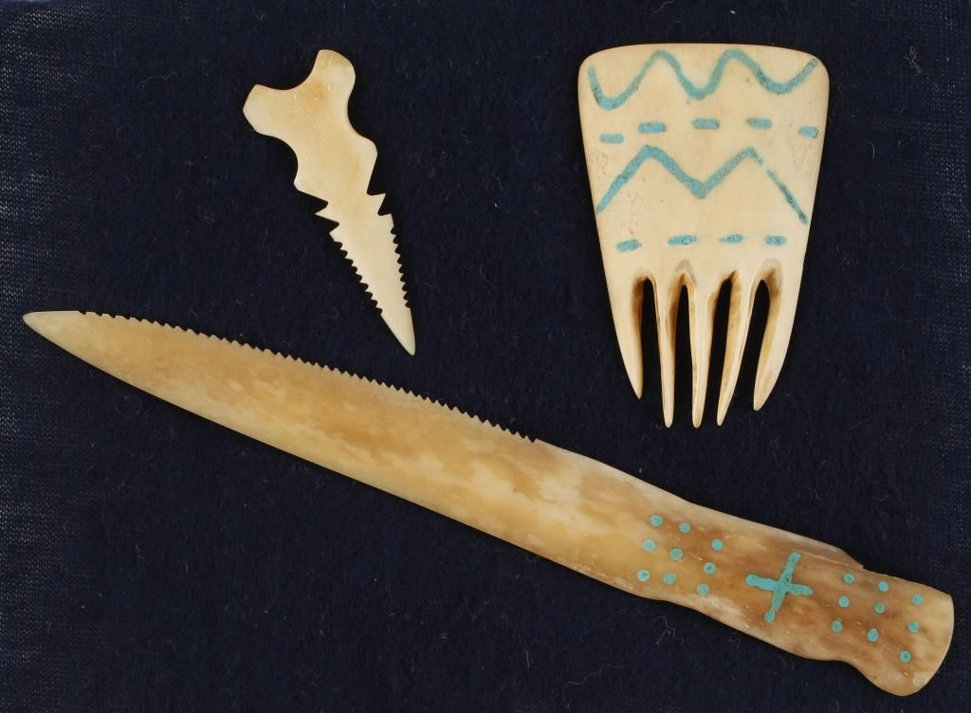
Native Americans used all parts of the animals they killed for many different purposes.

Slide 17
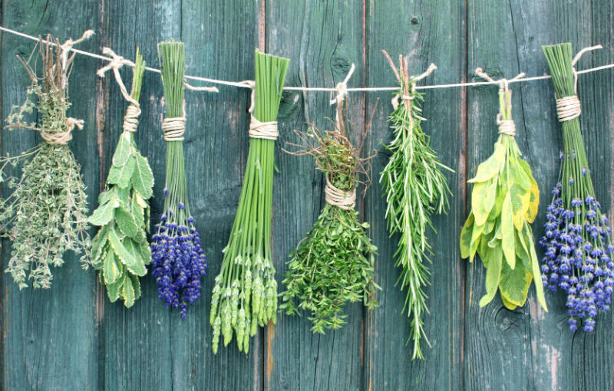
They also used plants from the forest for medicine.

Slide 18
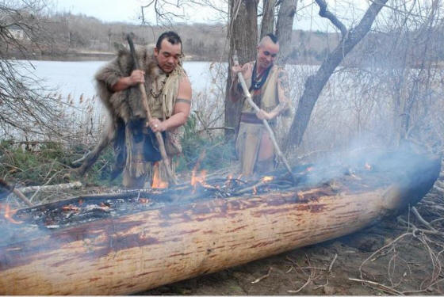
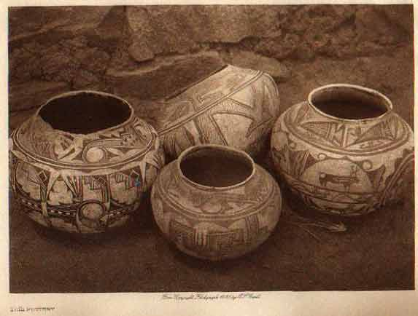
Eastern Woodland Indians built canoes from trees, made pottery from clay found in streams, and formed arrowheads and spearhead from stone.

Slide 19
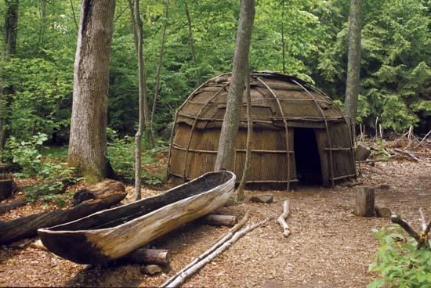
Exit Activity
Explain why you think Native Americans relied on nature for survival.
Share with a partner.

Slide 20
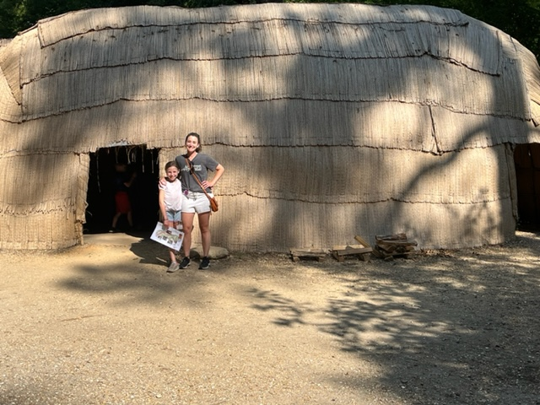

Slide 21
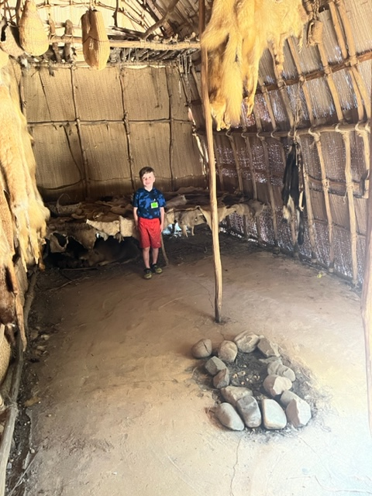

Slide 22
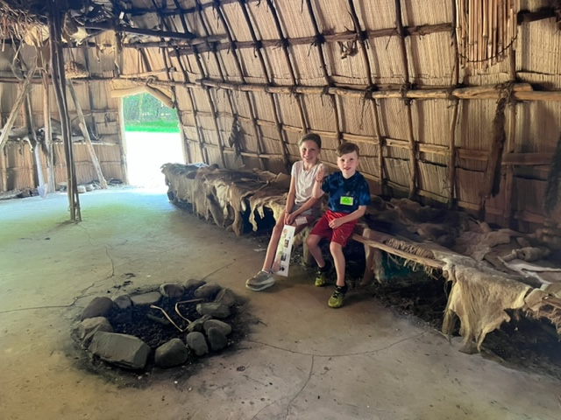

Slide 23
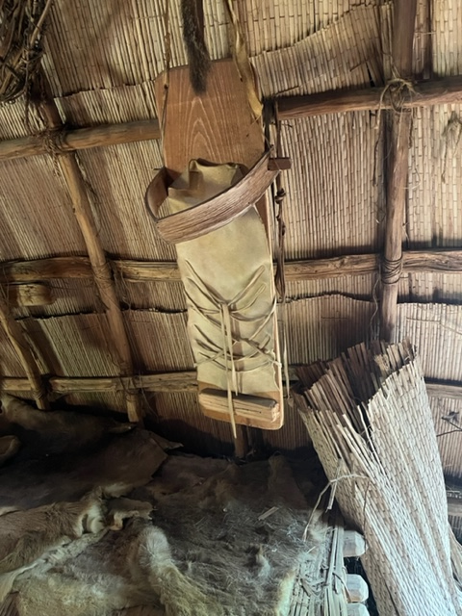

Slide 24
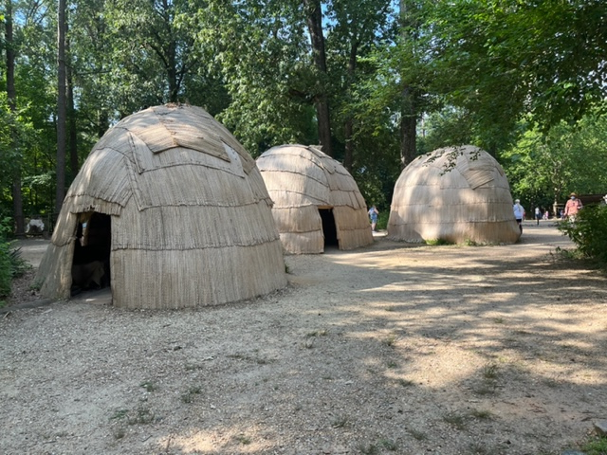

Slide 25
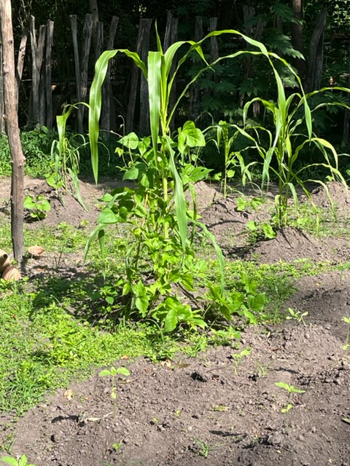

Slide 26
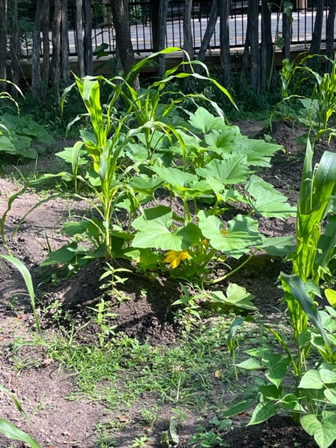

Slide 27
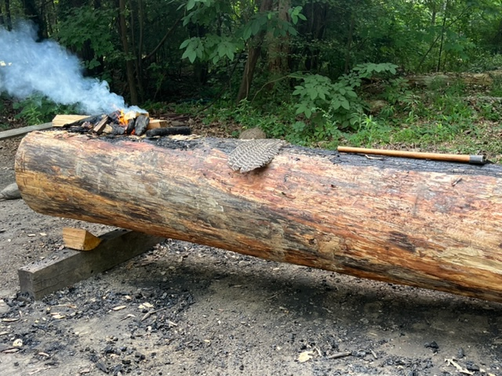

Slide 28
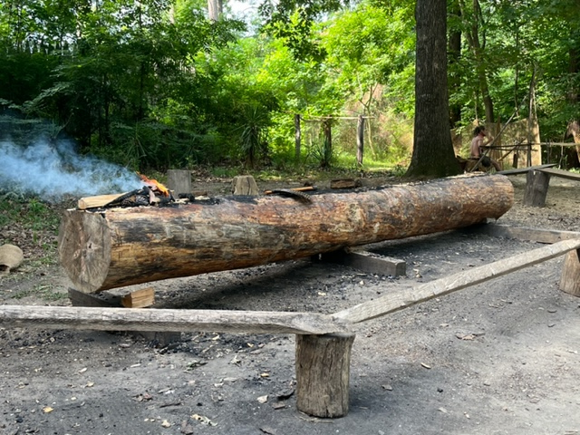

Slide 29
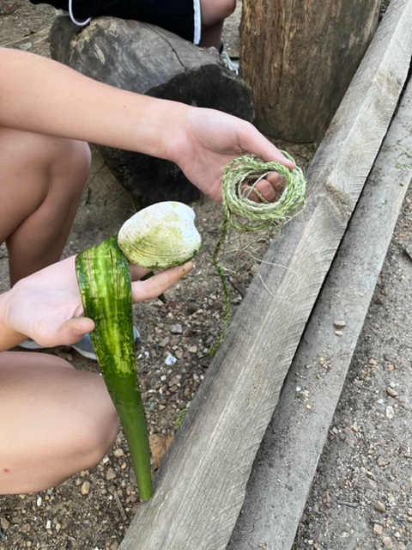

Slide 30
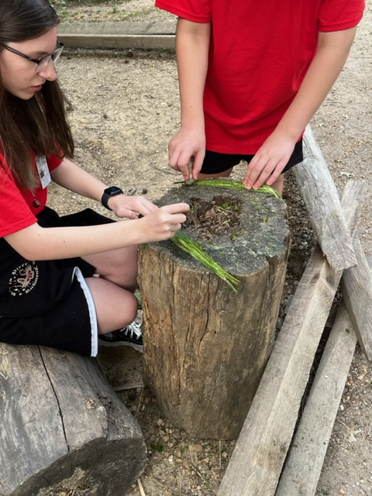

Slide 31
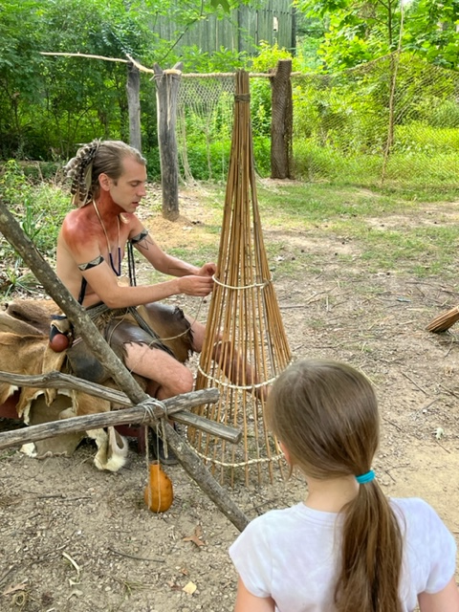

Slide 32
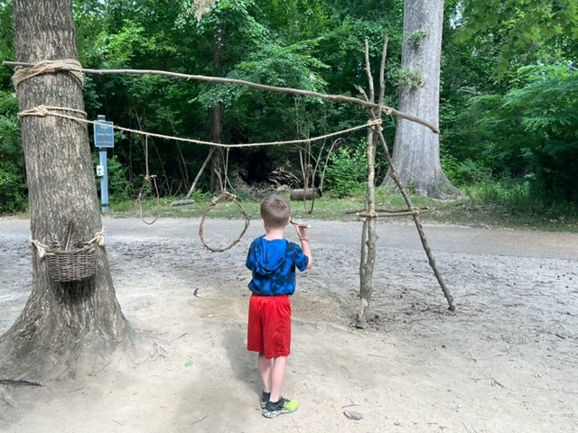

Slide 33
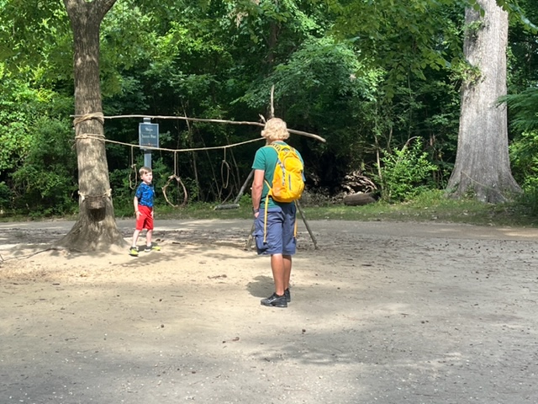

Slide 34
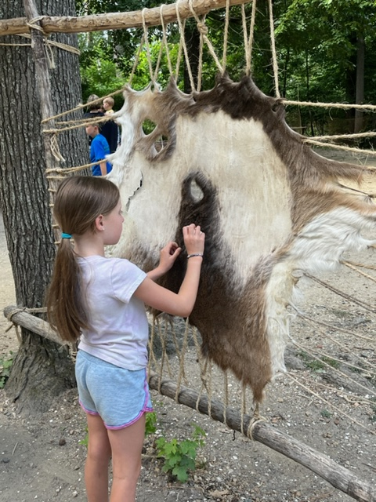

Slide 35
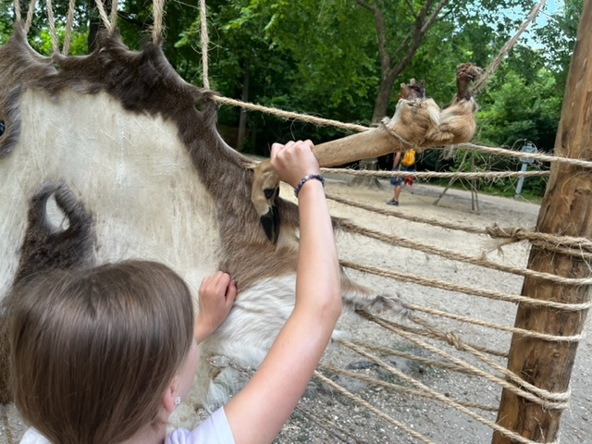

Slide 36
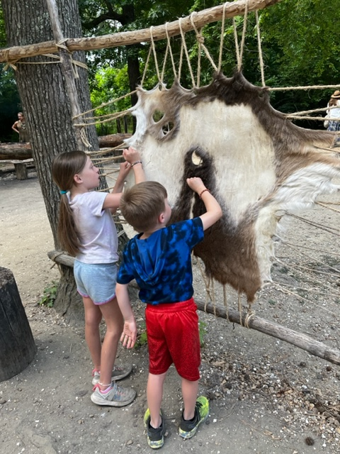

Slide 37
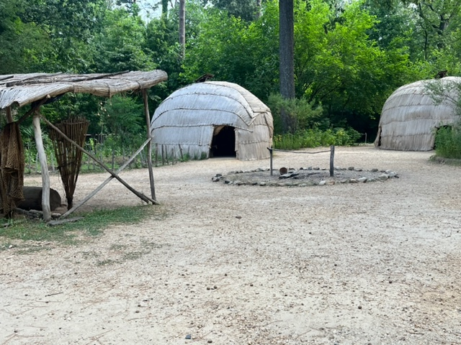

Slide 38
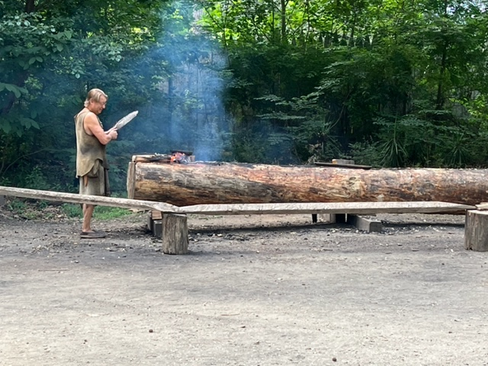

Slide 39
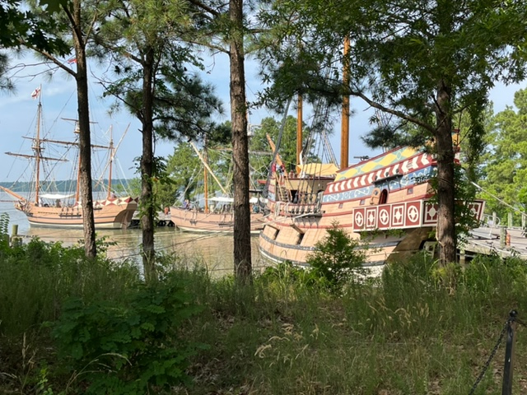

Slide 40
